Slide 1

01.
02.
THREE.JS
03.
01.
Immersive Web 001 // Introductions
Web-based 3D, structures, patterns, and quick starting.
01.
001

Slide 2
AGENDA
01.
02.
03.
1. Introductions
2. Syllabus
3. Live Coding - Setup
4. Homework
5. Reflection
01.
01.
002

Slide 3
01.
02.
03.
About Me: Brian Ho
01.
Front End Developer
Three.js Specialist
Creative Technologist
Adjunct Faculty - IMA / IMA Low Res
Discord: fakebrianho
Github: fakebrianho
Email: bh1525@nyu.edu
01.
002

Slide 4
01.
02.
03.
WHAT IS THREE.JS
01.
MODERN 3D GRAPHICS AT A FRACTION OF THE COST
Three.js is an open-source javascript library that allows us to easily work with web-based 3D graphics, build interactive experiences and create complex animations. Three.js is a wrapper library filled with utility classes and tools that make WebGL much easier to work with.
01.
002

Slide 5
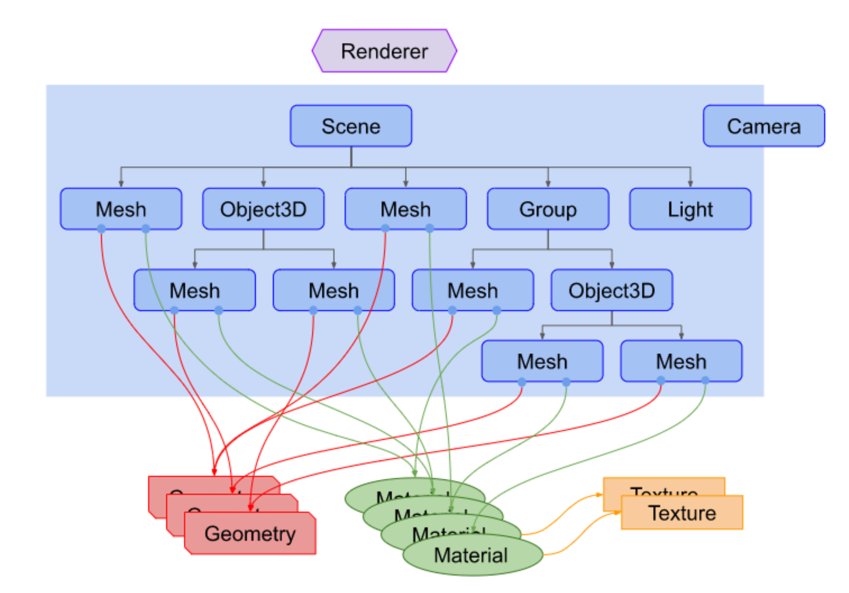
01.
02.
03.
01.
01.
From MDPI Paper: Development of a 3D WebGIS Application for the Visualization of Seismic Risk on Infrastructural Work
VISUAL DIAGRAM
003

Slide 6
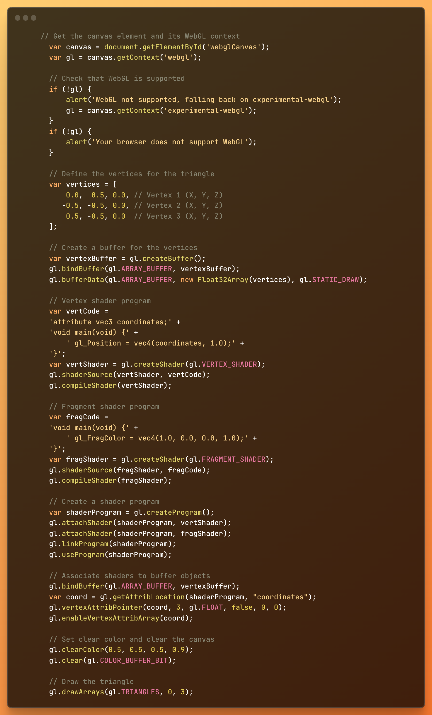
01.
02.
03.
WEBGL
01.
A MOST POWERFUL PAIN IN THE ASS
WebGL is a javascript API that allows us to use our GPU to render 2D and 3D graphics.
01.
998

Slide 7
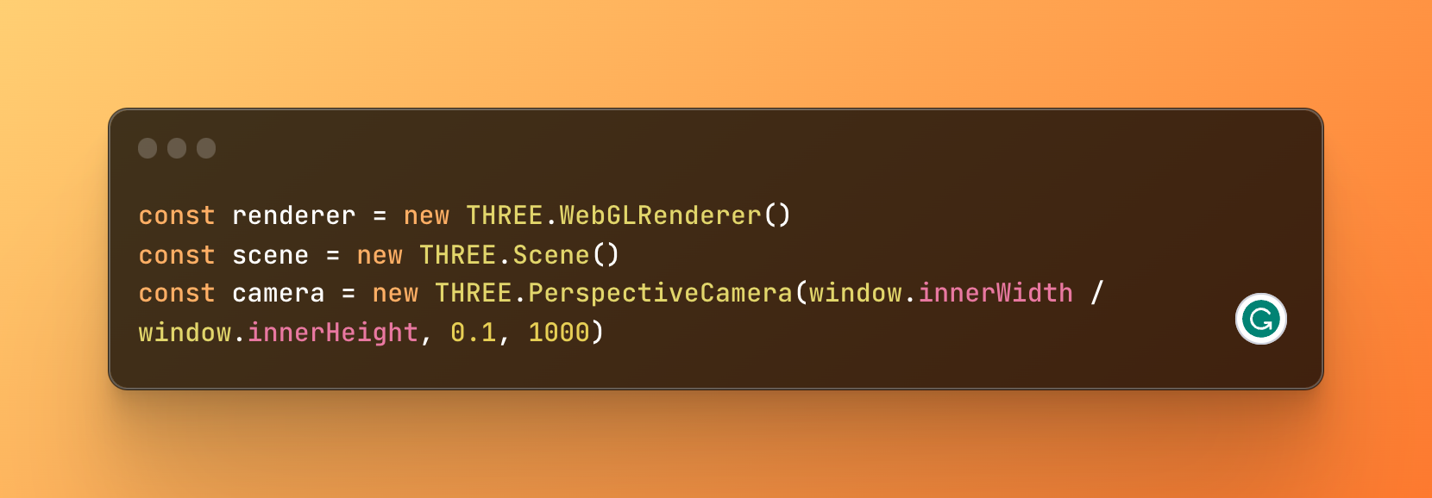
01.
02.
03.
ESSENTIALS
01.
LIGHTS, CAMERA, ACTION
Scene - A container for all our 3D things will exist.
Camera - The POV we have of our scene.
Renderer - Responsible for rendering our 3D scene onto our web page.
01.
004

Slide 8
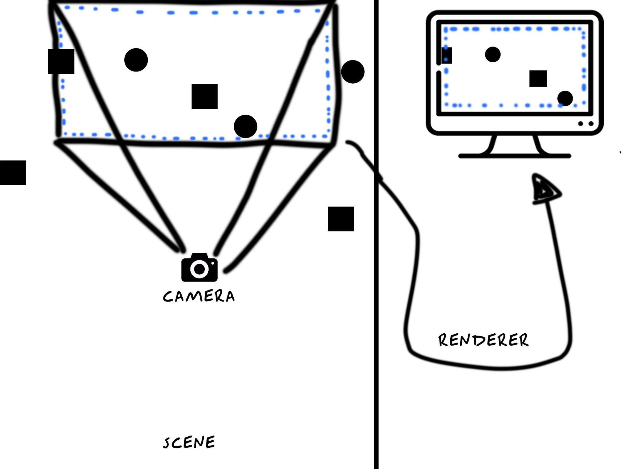
01.
02.
03.
01.
01.
002

Slide 9
TYPES OF CAMERAS
01.
02.
03.
Perspective Camera: Mimics the way our eyes see. Do you want things to look ‘realistic’, or ‘proportional’? Use a perspective camera.
01.
Array Camera: Multi-view rendering, split screen, multiple POV.
Stereo Camera: Renders the screen with two cameras to mimic two eyes. Useful for VR and parallax effects.
https://threejs.org/
Cube Camera: 360 view captured into a cube. Useful for reflections, refractions, and environmental effects.
01.
Orthographic Camera: Useful for 2D scenes and UI elements, whatever is rendered with an orthographic camera stays the same size regardless of its distance from the camera.
005

Slide 10
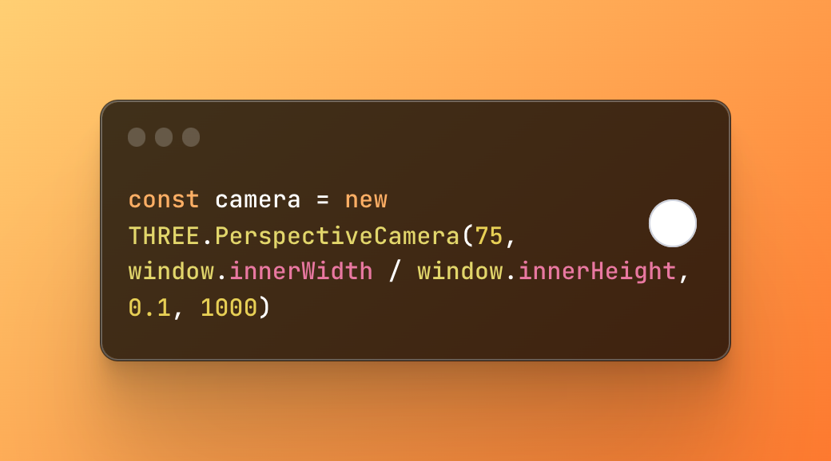
01.
02.
03.
CAMERA
01.
HOW WE VIEW THE SCENE
First Parameter:
Field of View
The open observable area an optical device can see or capture. Simply put, how wide our shot is.
Second Parameter:
Aspect Ratio
The ratio of an images width relative to it’s height.
01.
006

Slide 11
01.
02.
03.
CAMERA
01.
HOW WE VIEW THE SCENE
Third Parameter:
Near Frustum
How close your can you camera see? The edge of sight.
Fourth Parameter:
Far Frustum
How far can your camera see?
01.
007

Slide 12
01.
02.
03.
WHAT IS A 1000?
01.
Units in Three.js are arbitrary, it can be anything. It’s 1000 units of something. If you want to model something life-size you might decide 1 unit equals 1 meter, it can be 1 ft it doesn’t matter. What matters if your ratios.
01.
008

Slide 13
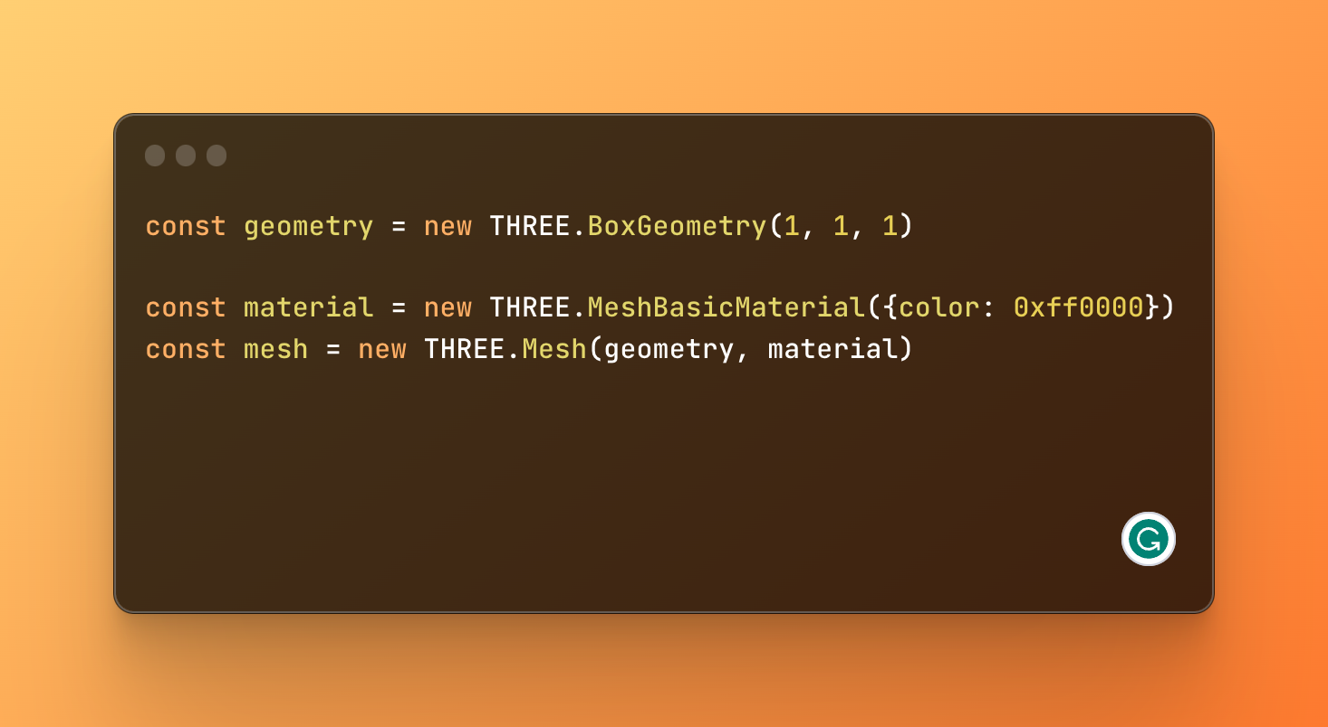
01.
02.
03.
MESHES
BUILDING BLOCKS OF THREE.JS
01.
A 3D object created by defining its shape and appearance.
Every mesh in Three.js is made up of 2 components, a geometry and a material.
01.
009

Slide 14
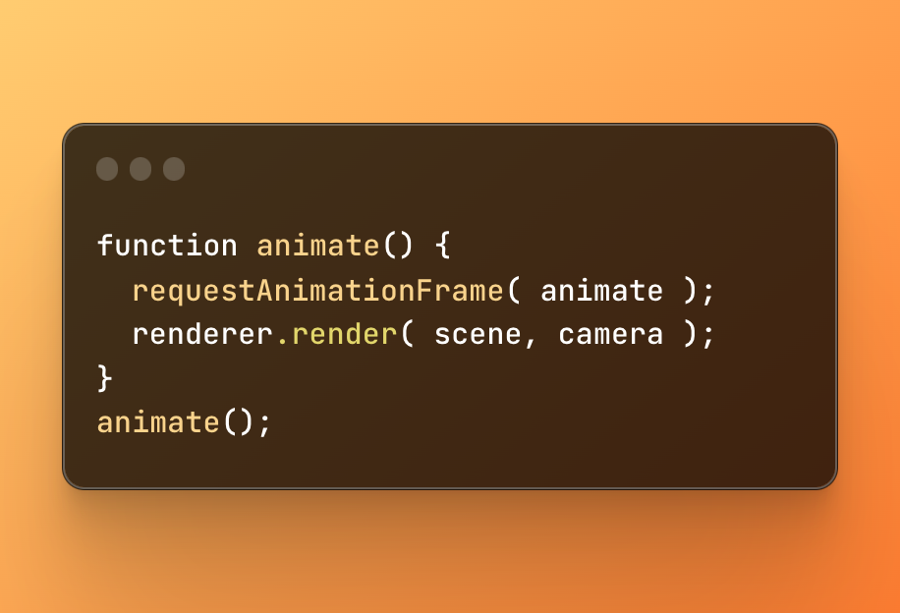
01.
02.
RENDERING
03.
DRAWING OUR SCENE FRAME BY FRAME
01.
In Three.js we utilize requestAnimationFrame() to create a continuous 60 frames per second animation loop. If you’re coming from P5 it’s our version of a draw loop.
01.
60 times a second we call renderer.render() a method that:
Clears our canvas
Checks to see if any objects, lights or cameras have moved.
Determines which objects are visible from the camera’s POV.
Calculates our each visible object should appear based on their materials, lights, position etc.
Computes and draws a 2D image of our 3D scene to the screen.
010

Slide 15
01.
WORKFLOW
02.
THE BASIC WORKFLOW OF A THREE.JS APPLICATION
03.
01.
Setup
Camera
Scene
Renderer
Add Meshes
To Scene
Create some meshes
Javascript
Render
01.
Hire our director of photography, choose our set, set up our stage.
Cast our actors, do their hair and makeup.
Set up our scene! Actors go to your marks.
Provide our actors with a script
Action!
011

Slide 16
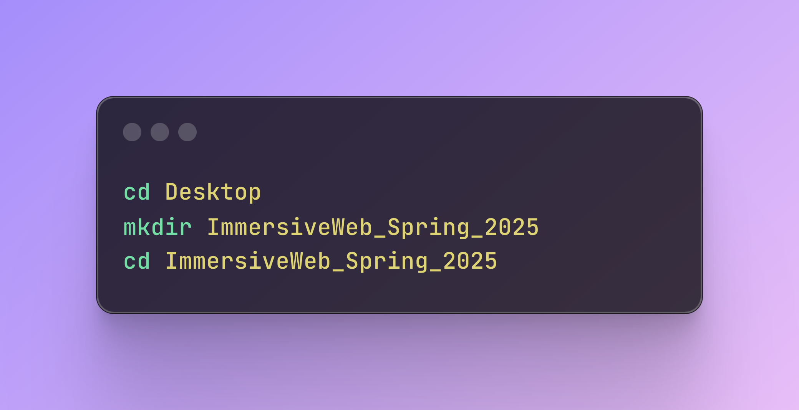
01.
02.
03.
QUICK START
01.
LET’S GET STARTED
cd = Change Directory
mkdir = Make Directory
01.
007

Slide 17
VITE.JS
01.
02.
03.
01.
A super fast web development module bundler and build tool.
TLDR:
Let’s us easily use NPM packages.
01.
002

Slide 18
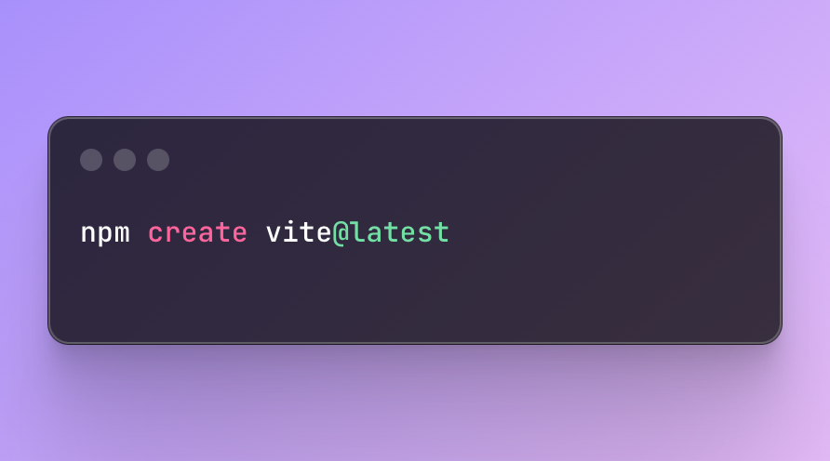
01.
02.
03.
QUICK START
01.
LET’S GET STARTED
01.
007

Slide 19
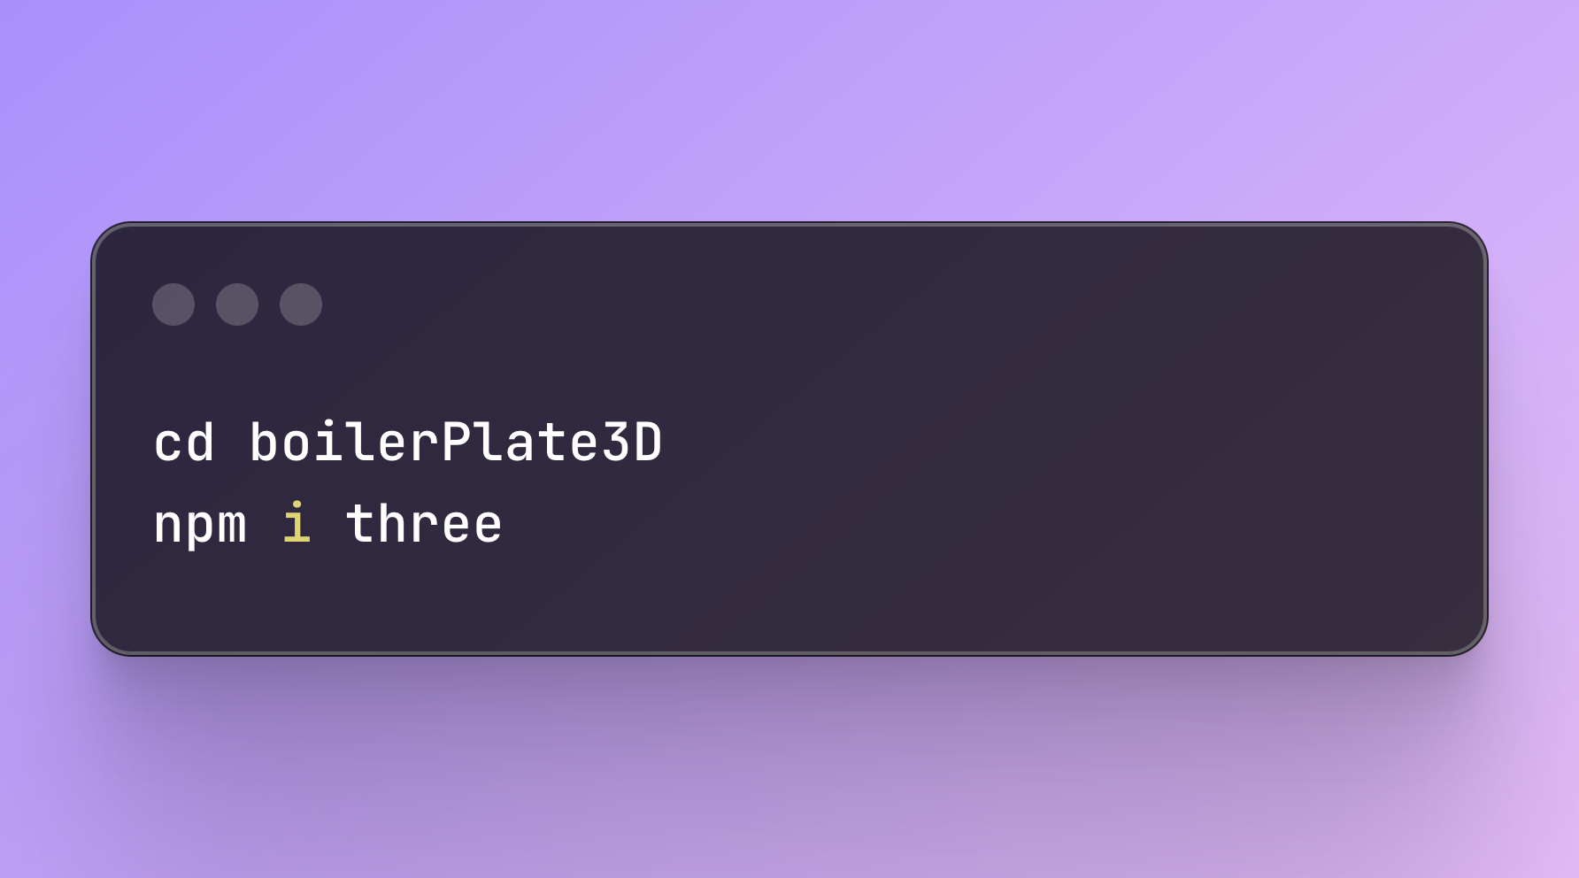
01.
02.
03.
QUICK START
01.
LET’S GET STARTED
npm i = npm install
code . = open current folder in default text editor
01.
007

